Slide 2

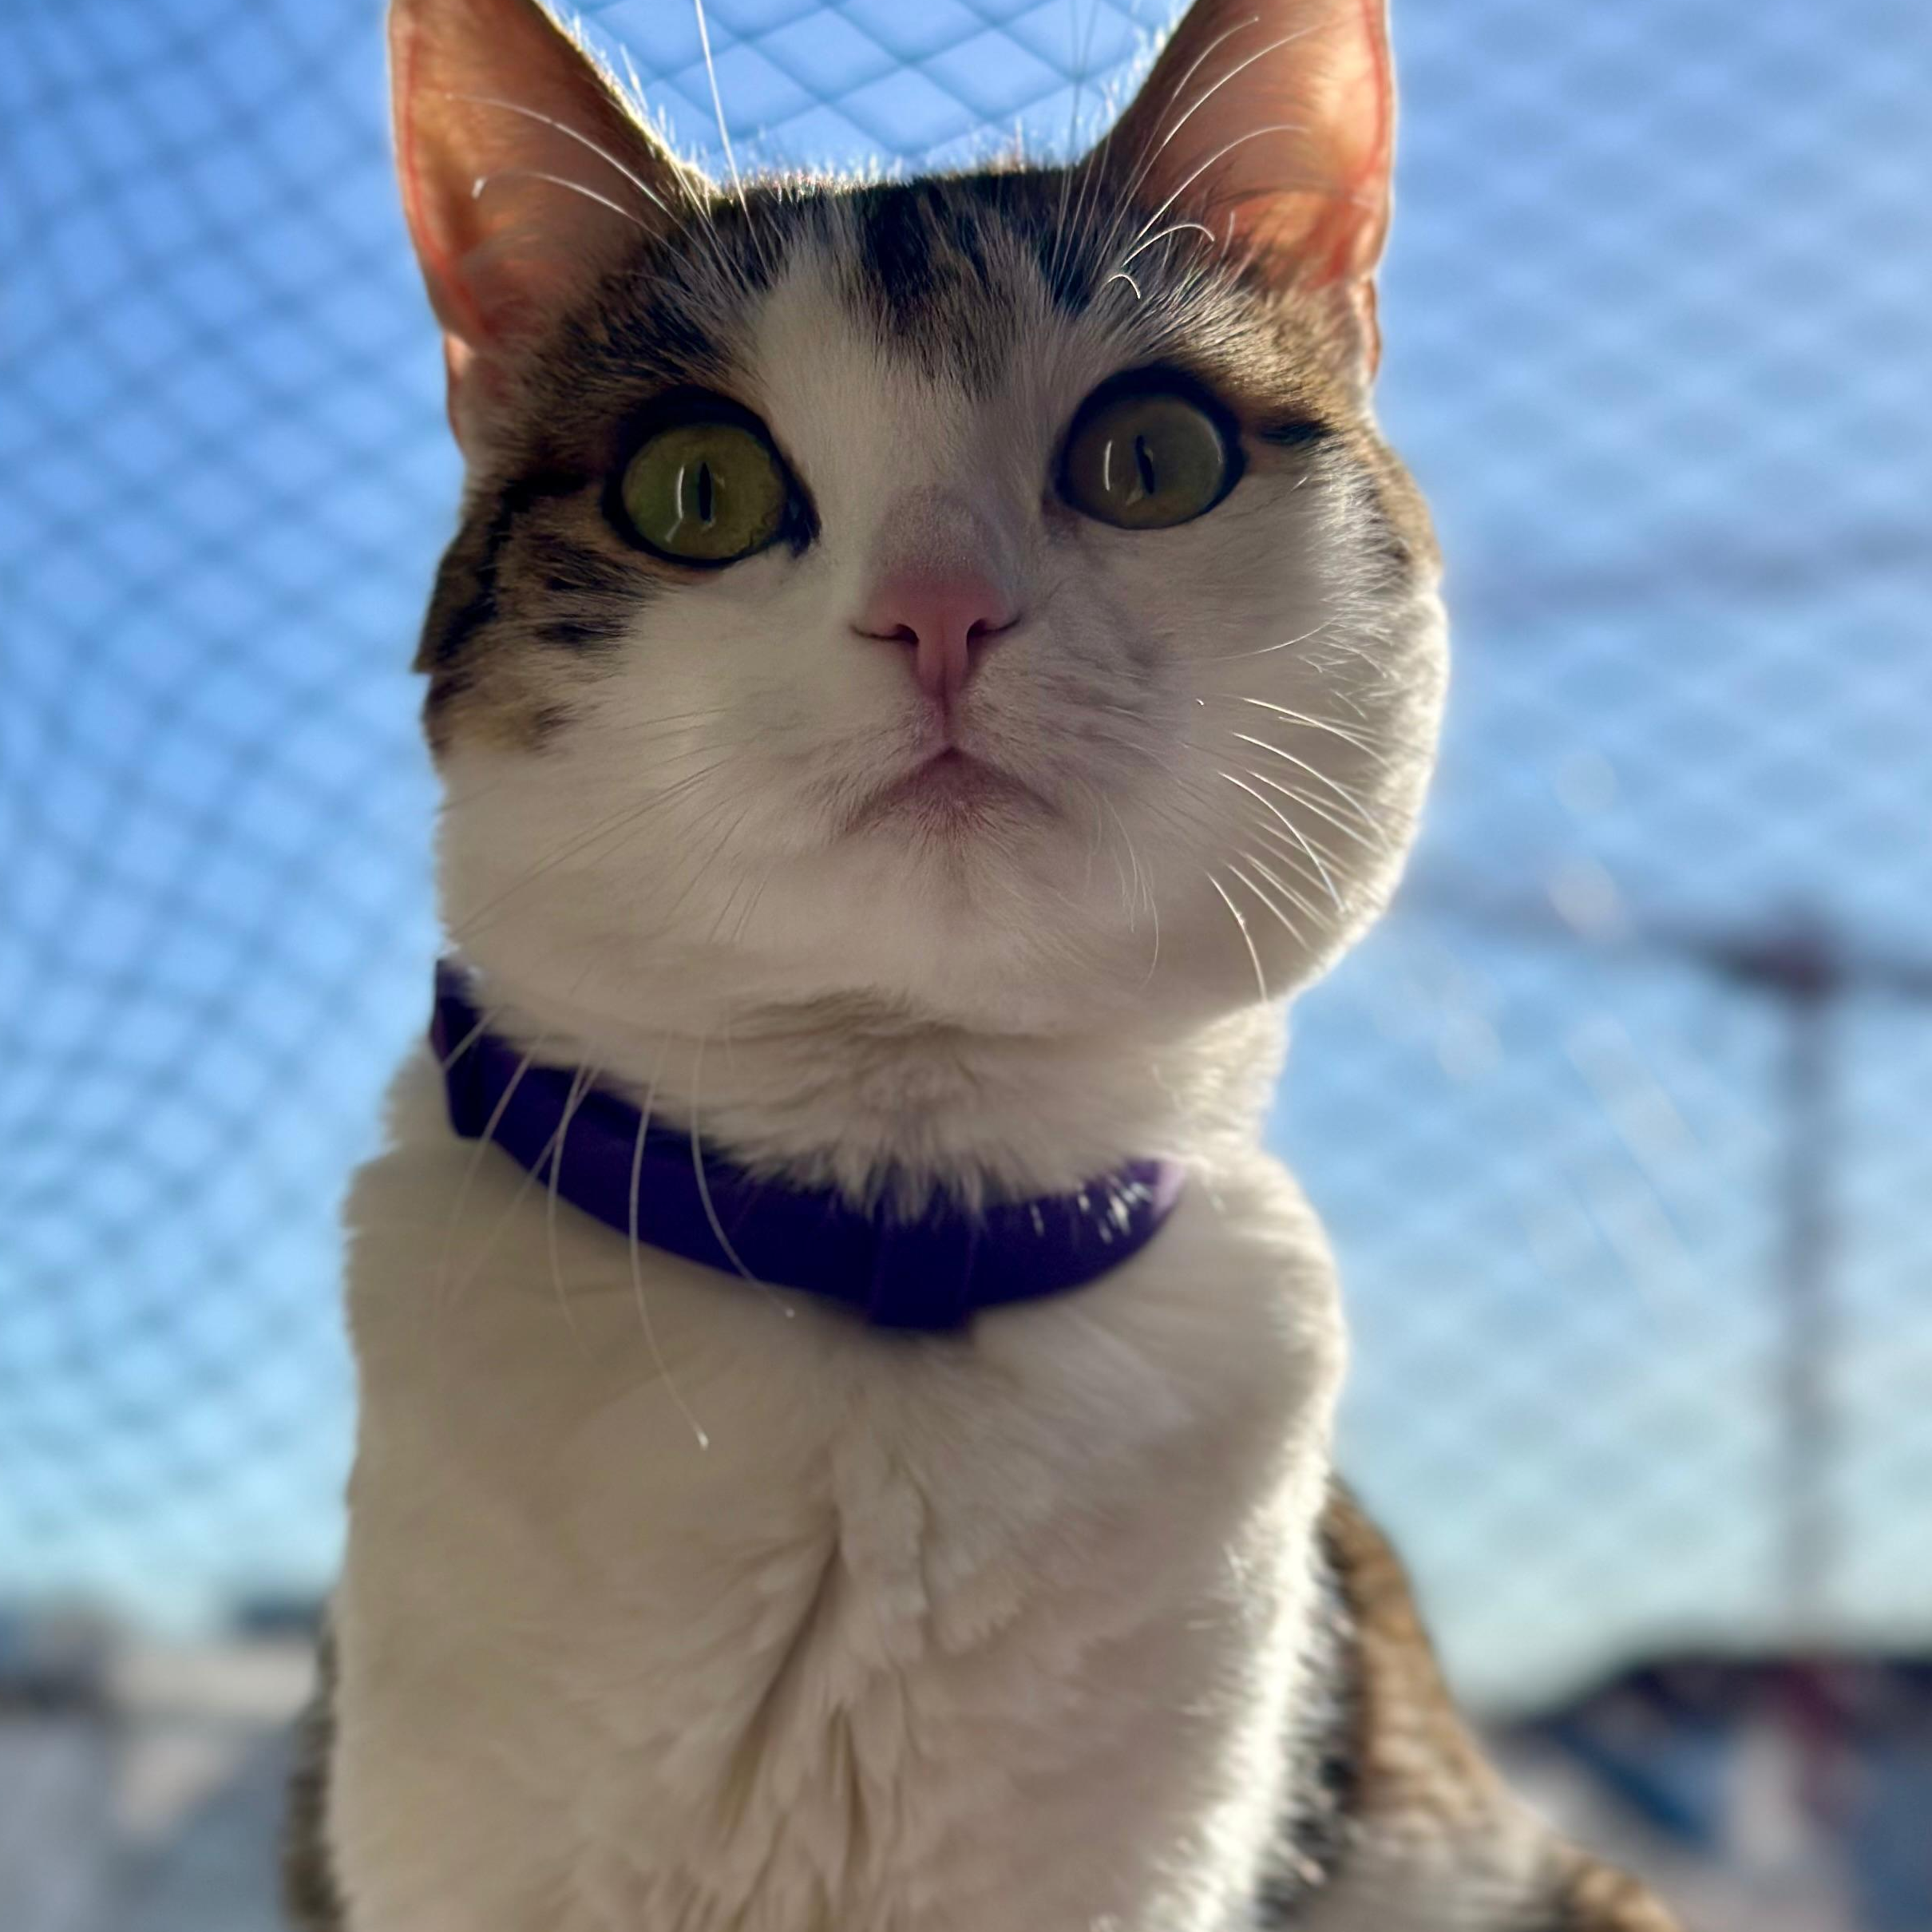
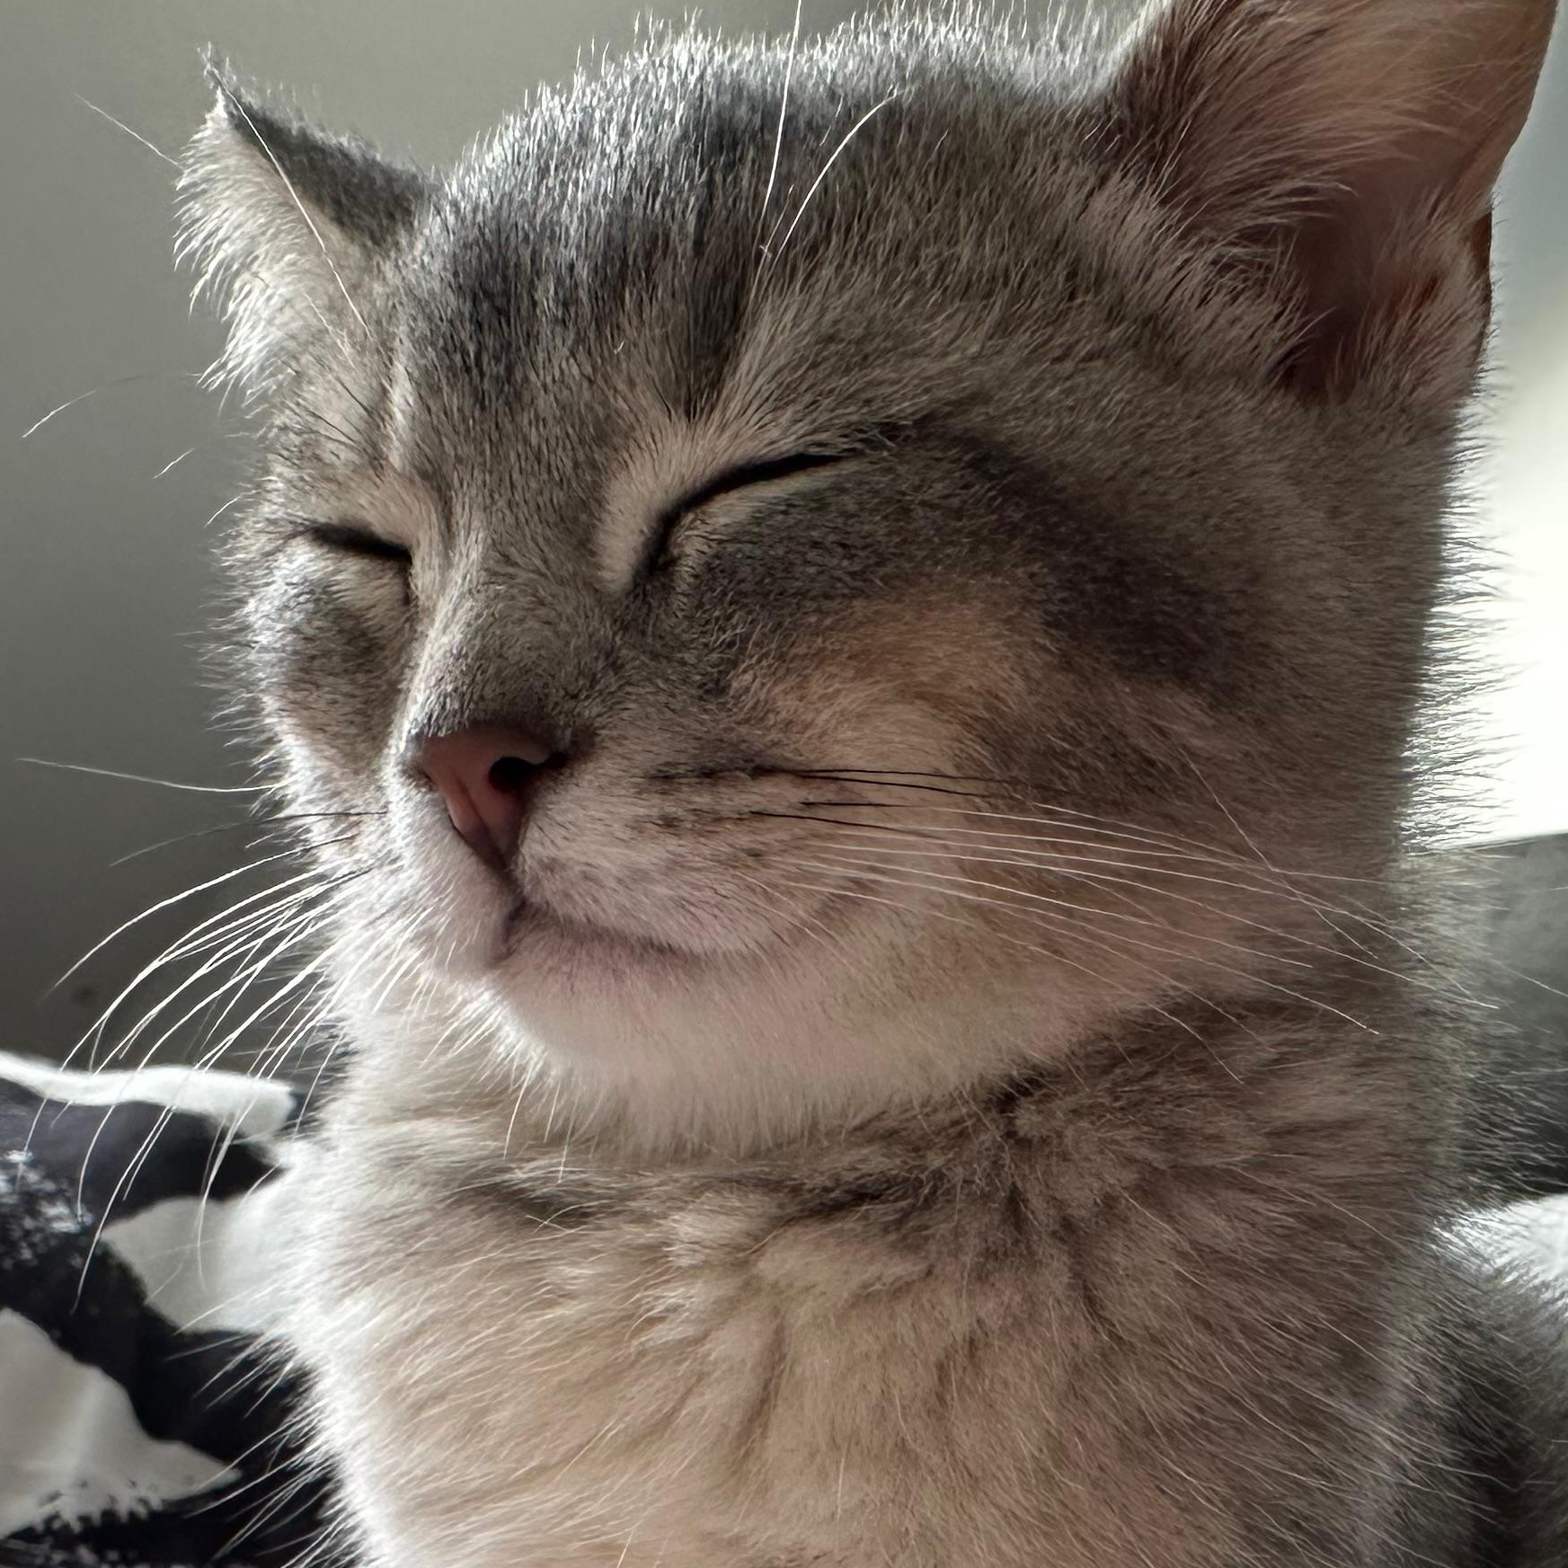

Cat Expert Chat
By Diego Inclán Soto
Balou
Auri

Slide 3


Slide 4
...you could ask all your concerns about your feline friend to a cat expert like Jackson Galaxy?
All your concerns could be address with a simple chat with the Ai version of him.

Slide 5



Technical Summary:
YT_dlp: To download audio files from Youtube
Whisper: To transcribe the audio from videos
Langchain + LangSmith: To handle conversational logic and prompt chains, including tracing.
ChromaDB (VectorDB): To handle video content indexing and retrieval with embeddings.
RAG (Retrieval-Augmented Generation): To provide accurate, informative answers.
Deployment on Gradio: To provide a user-friendly UI for interaction.
Agents for Automation: To reduce code repetition and simplify development.
Architecture of your solution (Agents, LLMs, RAGs…)
Describe how they work together
Include a diagram
If you deployed, explain it here

Slide 6
Dataset
Youtube Channel, Playlist based on 16 videos concerning cat behvior.
The use of YT_dlp as my webcrawler for download the audio directly from the youtube channel.
Whisper from OpenAi to do the Audio transcription processing. Taking in total around 1 minute between download the audio and whisper doing the transcription. (Also, dependant of the video length)
LangSmith
User Question
User Feedback
Youtube
YT-DLP
Whisper
Chromadb
Memory Management
Gradio
RetrievalQA Chain with GPT-3.5-turbo
Notes:
Where you get your data from (Youtube, Web, Books…)
How you retrieve it (libraries, web scraping…)
Preprocessing? If relevant, a chart that shows the impact of the preprocessing on the metrics go here

Slide 7
Q&A Agent
Vector Storage:
ChromaDB is utilized to store the transcriptions as vector embeddings, allowing for efficient retrieval when needed.
OpenAIEmbeddings are used to convert the transcriptions into numerical vectors that can be stored in ChromaDB for semantic search purposes.
Retrieval-Augmented Generation (RAG):
A RetrievalQA chain is used to implement the Retrieval-Augmented Generation strategy. This chain uses the embeddings stored in ChromaDB to retrieve relevant information based on user queries.
The chain has been optimized for speed by reducing the number of retrieved documents (k) and limiting the number of tokens used in the language model's responses.
Notes:
Describe your Q&A Agent in detail
General architecture
Memory
Anything else you used

Slide 8
LangChain Agents: The conversational flow is managed using LangChain Agents. These agents orchestrate the interaction between different tools, such as generating responses and retrieving information.
Gradio: used for user interaction, providing an easy-to-use web interface for users to ask questions and receive responses from the Q&A Agent.
Memory Handling
Cat Name Memory:
The chatbot uses a simple list-based memory (cat_name_memory) to remember the user's cat's name across interactions.
The memory is limited to the last three interactions, ensuring the system doesn't grow indefinitely, and it keeps the conversation relevant to the user's context.
When a user mentions their cat's name, it is stored in memory and used in subsequent responses to personalize the interaction.
Conversation Flow Memory:
A global variable (first_time_greeting) is used to ensure a warm welcome message is delivered to users on their first interaction.
Gradio maintains the conversation state, and an asynchronous function (ask_question_gradio) is used to handle the user's queries, preventing the interface from freezing or becoming unresponsive.

Slide 9
Tool Descriptions
Google/Web search.
Youtube: For cat video reserch.
Whisper Model: Used for audio transcription.
ChromaDB and OpenAIEmbeddings: Store transcriptions as vector embeddings for efficient retrieval.
RAG: A RetrievalQA chain is used to implement the Retrieval-Augmented Generation strategy. This chain uses the embeddings stored in ChromaDB to retrieve relevant information based on user queries.
LangChain Agents: Automate the use of the tools, managing workflows to ensure smooth interaction.
OpenAI GPT 3.5 Turbo LLM understanding and Response Generation.
Gradio Interface: A user-friendly interface to enable users to ask questions, with answers that are enriched with personalized cat care advice.

Slide 10
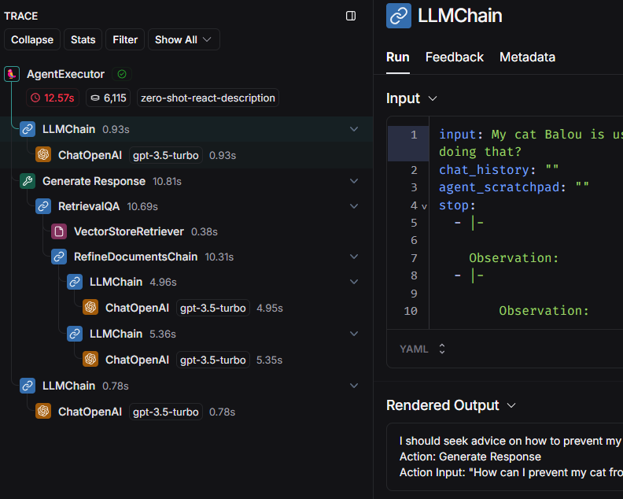
Evaluation
Accuracy of Transcriptions:Whisper Transcriptions: Evaluate the quality of the transcriptions generated by Whisper from YouTube videos. This involves comparing the transcribed text against manually verified transcripts to determine the accuracy and reliability of the transcriptions.
Retrieval Effectiveness:Embedding Quality: Ensure that the OpenAIEmbeddings correctly represent the semantic content of the transcriptions. This is measured by the relevancy of documents retrieved by ChromaDB based on user queries.
Retrieval Consistency: Verify that the RetrievalQA Chain consistently retrieves the most relevant transcriptions, ensuring that users receive accurate and relevant information.
User Interaction Evaluation:
First-Time Greeting: Check that the first-time greeting is triggered appropriately during the initial interaction, creating a welcoming user experience.
Personalization: Evaluate how well the chatbot remembers and utilizes the cat's name across multiple interactions, ensuring that responses are personalized, and the memory works as intended.

Slide 11
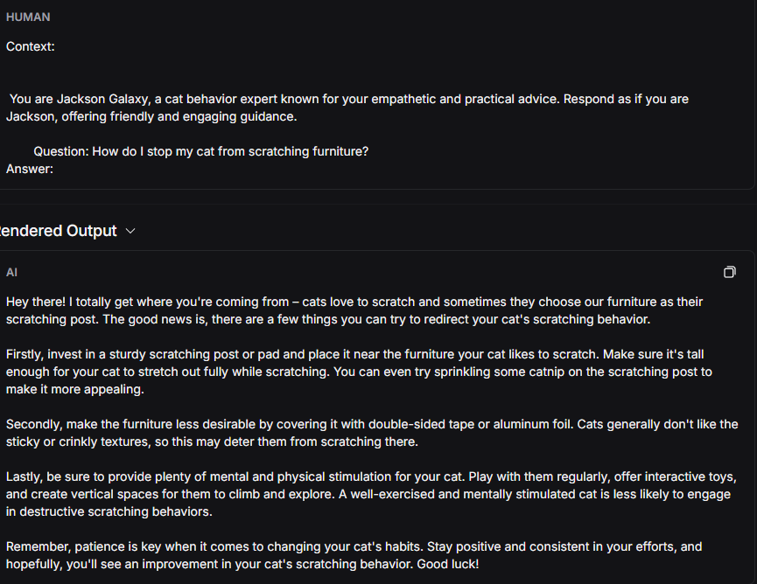
Evaluation
Response Quality:
Generated Responses: Assess the responses generated by the GPT-3.5-turbo model for coherence, empathy, and detail. This involves manual review of the answers given to users and ensuring that the advice is consistent with the tone of Jackson Galaxy.
Closing Signature: Confirm that each response ends with the closing phrase, "Good luck! 😺🐾 #TeamCatmojo," to maintain consistency and a friendly tone.
Speed and Performance: Latency Measurements: Measure the time taken for the agent to retrieve relevant information and generate a response. The goal is to ensure that responses are delivered within an acceptable time frame to maintain user engagement.

Slide 12
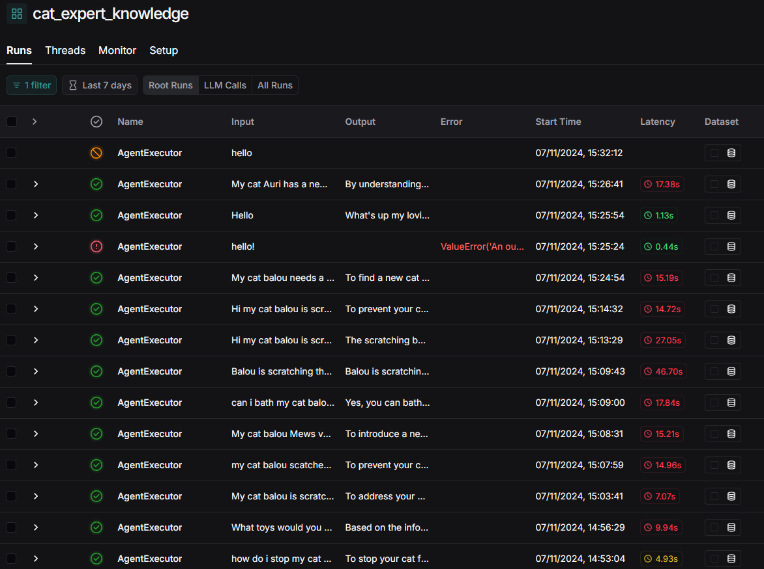
Evaluation
Gradio Interface Stability: Test the Gradio Interface for stability during repeated interactions to make sure there are no performance issues or crashes, especially during prolonged conversations.
User Feedback:Collect user feedback through surveys or ratings integrated into the Gradio interface. This helps in understanding how well the Q&A Agent is meeting user expectations and identifying areas for improvement.
Error Handling and Recovery:Exception Management: Review error logs generated by the system to identify common failure points. Ensure that the ask_question_gradio function effectively catches and reports errors without crashing the interface.
Memory Management: Validate that the memory management (such as the cat_name_memory and first_time_greeting variables) works as expected and that memory does not overflow or persist unnecessarily.

Slide 13
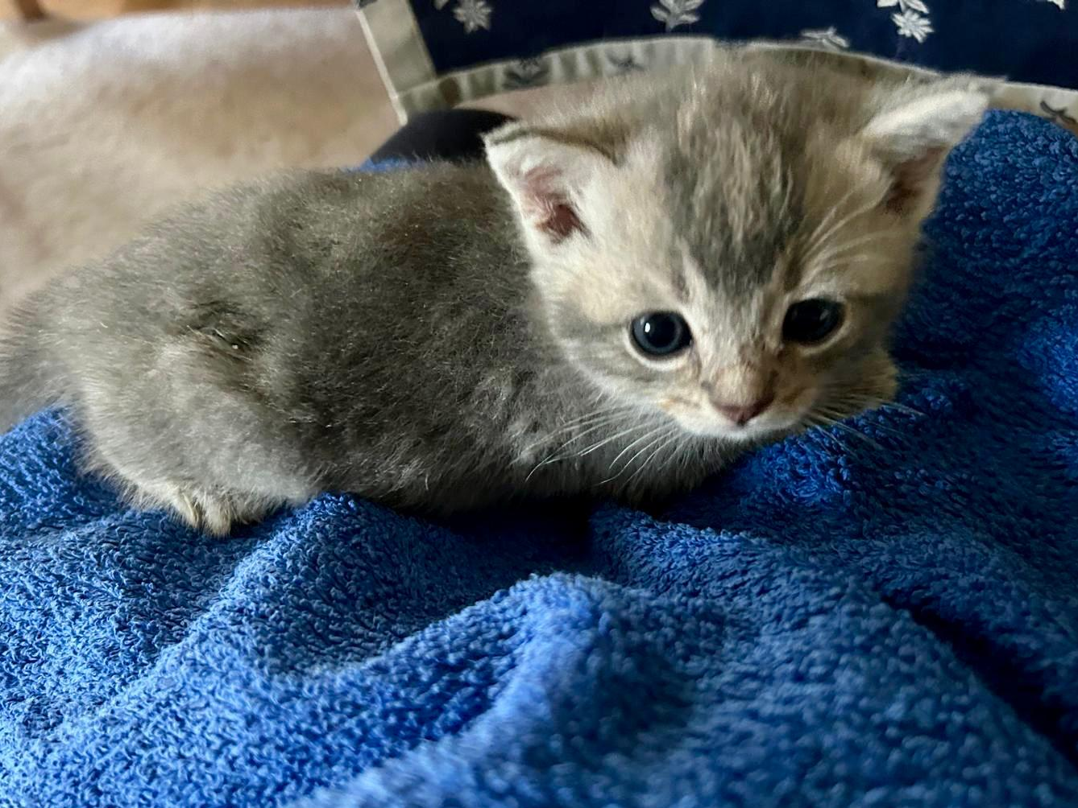
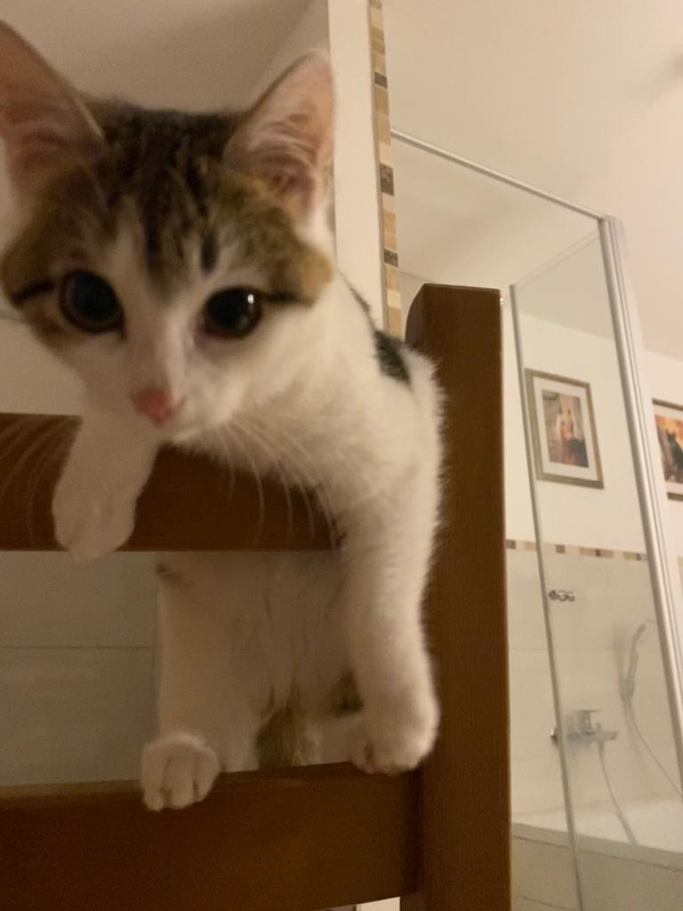
Conclusion

Slide 15
Demo (2 minutes max)
Live demo of your chatbot
You can run it locally (from your computer) or from a deployed site (Gradio, …)
Have images of test runs as backups in case the demo crashes

Slide 16
Tips
Remember to use diagram instead of code. Simplify when you can!
Show your creativity. It makes your presentation more rememberable.
Save your plots in high quality and always compare things in context.
Rehearse the presentation.

